Slide 1
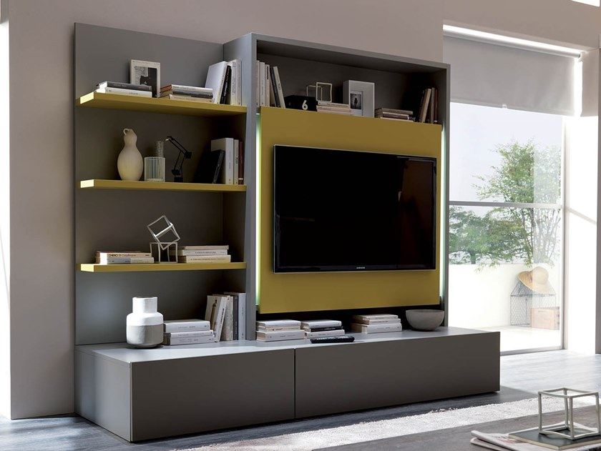
Unit 8

Slide 2

Opener

Slide 3
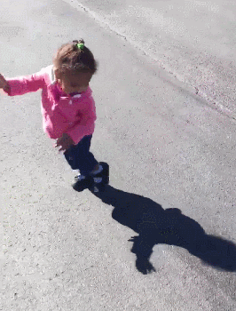
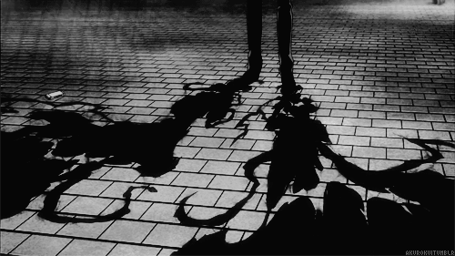
What is as big as you are and doesn’t weigh anything?

Slide 4

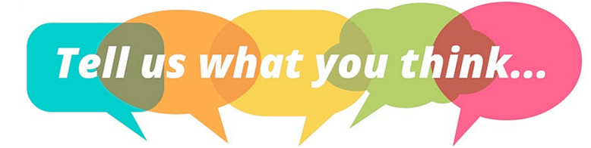



Slide 5
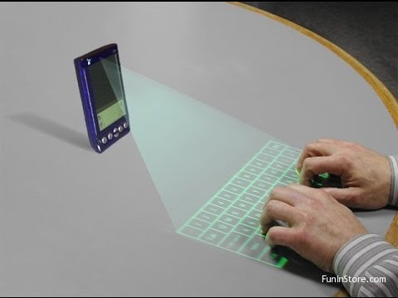
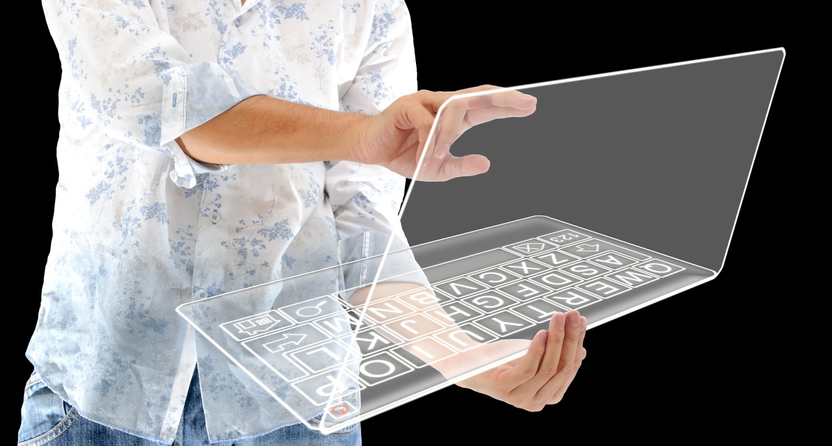
What inventions could be invented in the future?

Slide 6

Let’s study the new words, shall we?

Slide 7

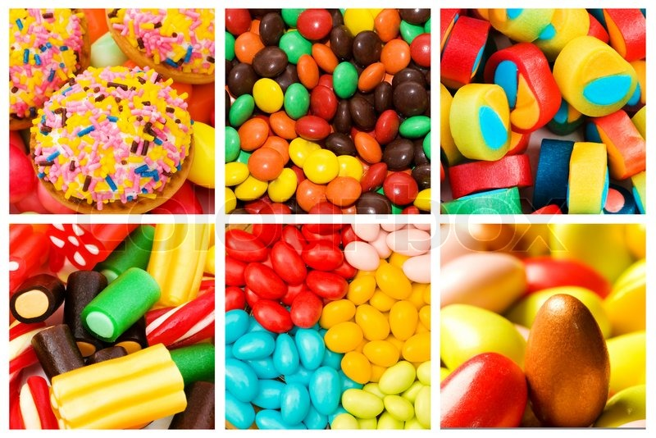
There are various sweets.
What’s your favourite one?

Slide 8
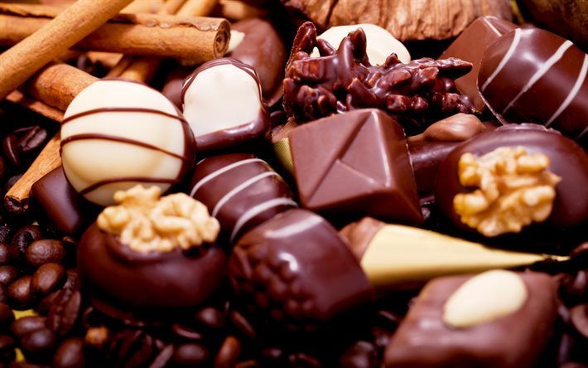

various
many; different

Slide 9
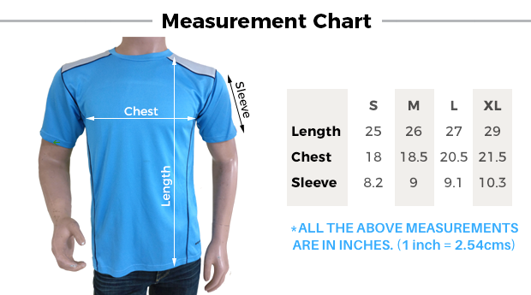
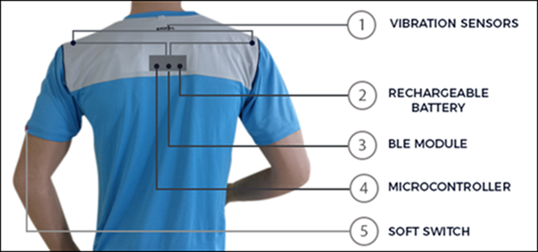
This wearable T-shirt can track your daily steps, calories burned, distance run or walked floors, just like a fitness tracker.

Slide 10
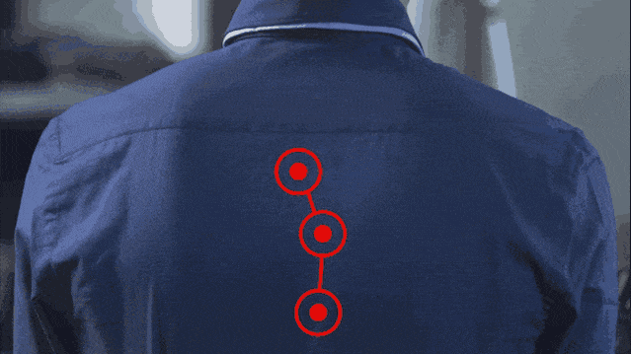
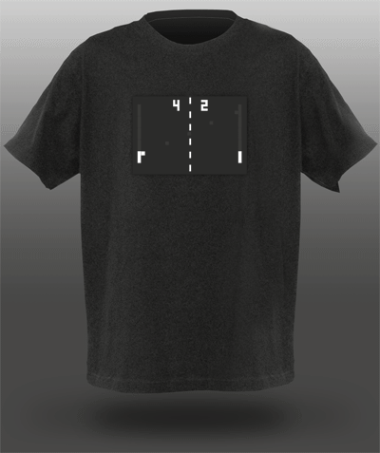
wearable
clothes that are wearable are easy to wear

Slide 11
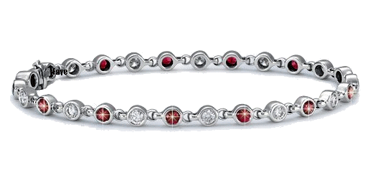
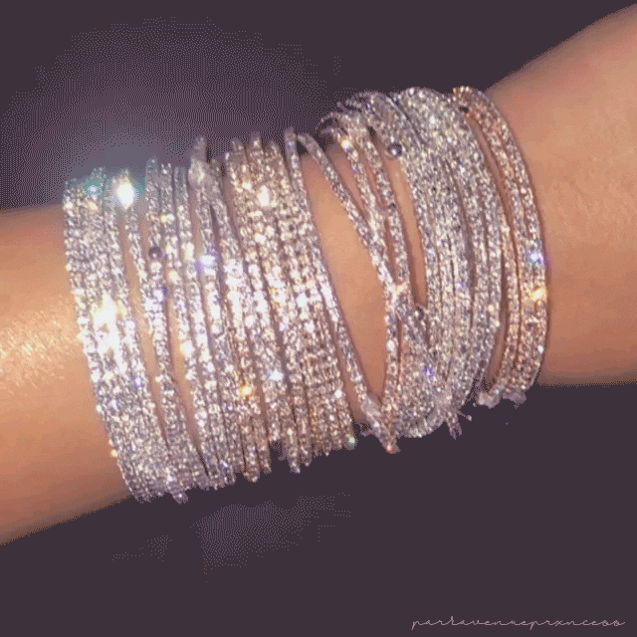
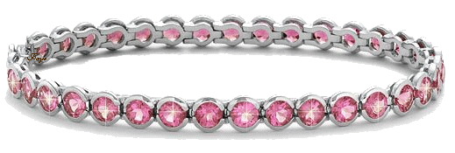
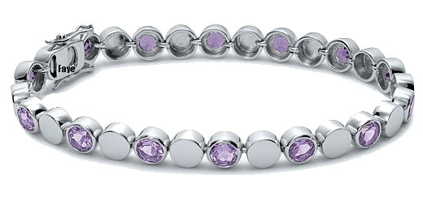
Girls like wearing bracelets.

Slide 12
bracelet
a piece of jewellery that is worn around the wrist or arm

Slide 13
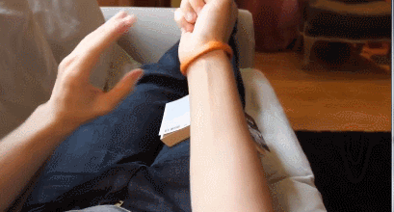
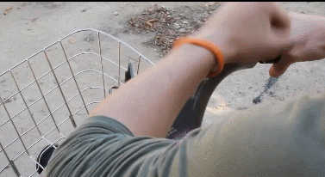
This is an intelligent wearable bracelet. Imagine that your skin becomes
a touchscreen.

Slide 14
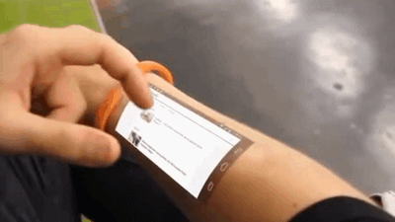
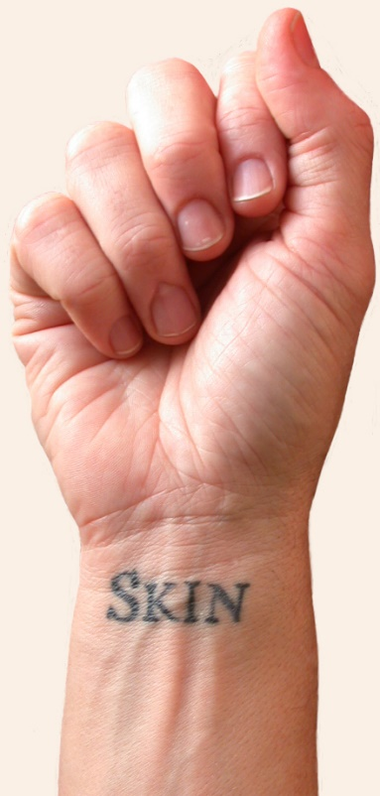
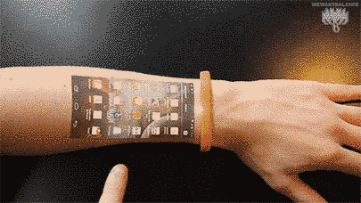
skin
the natural outer layer that covers
a person, animal, fruit, etc.

Slide 15
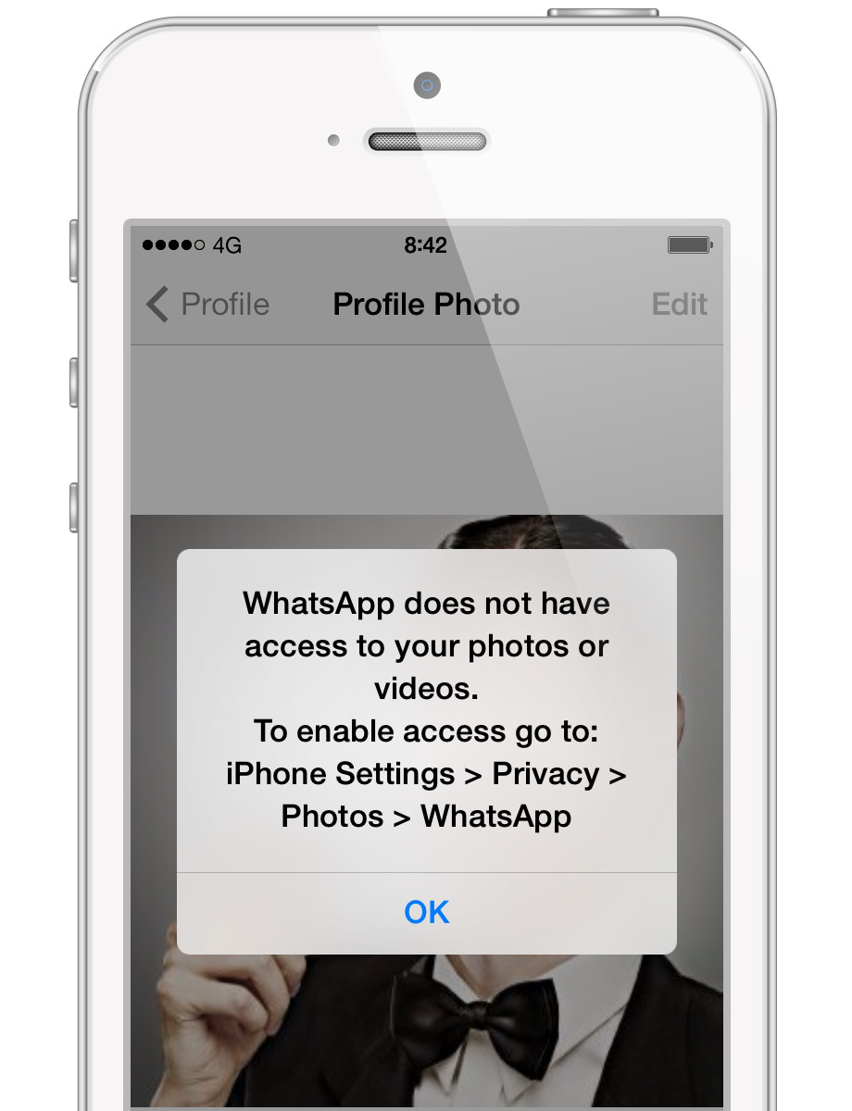
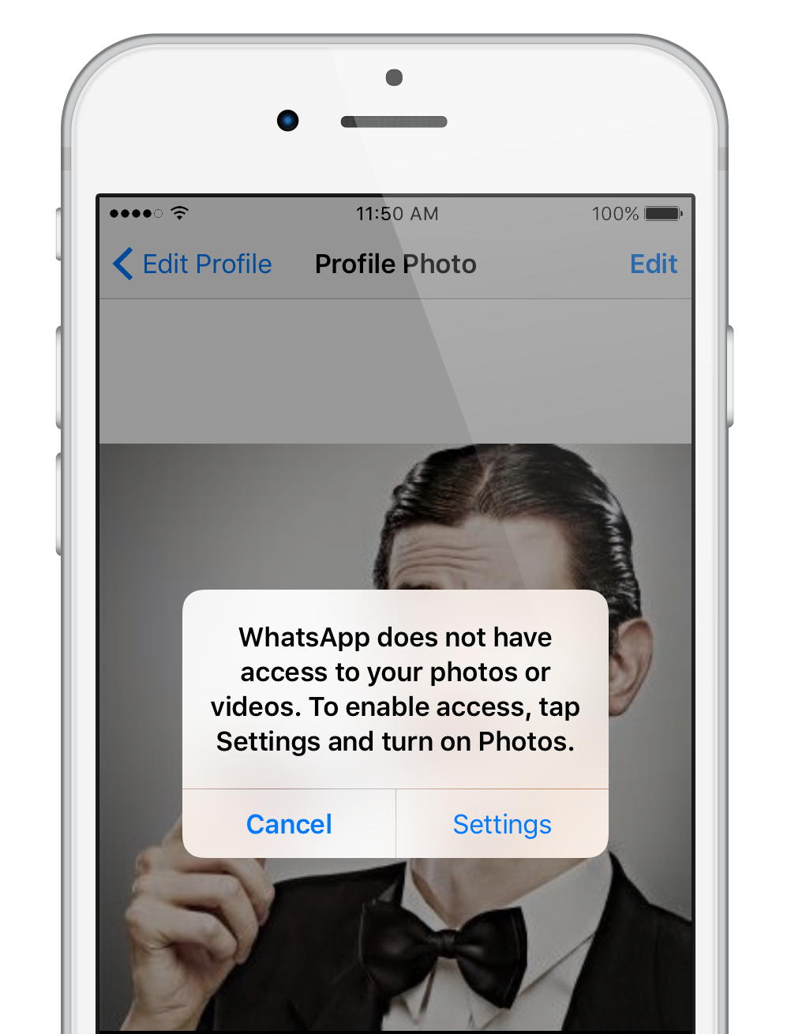
WhatsApp doesn’t have access to your photos. You can enable access by tapping Settings and turning on Photos.

Slide 16
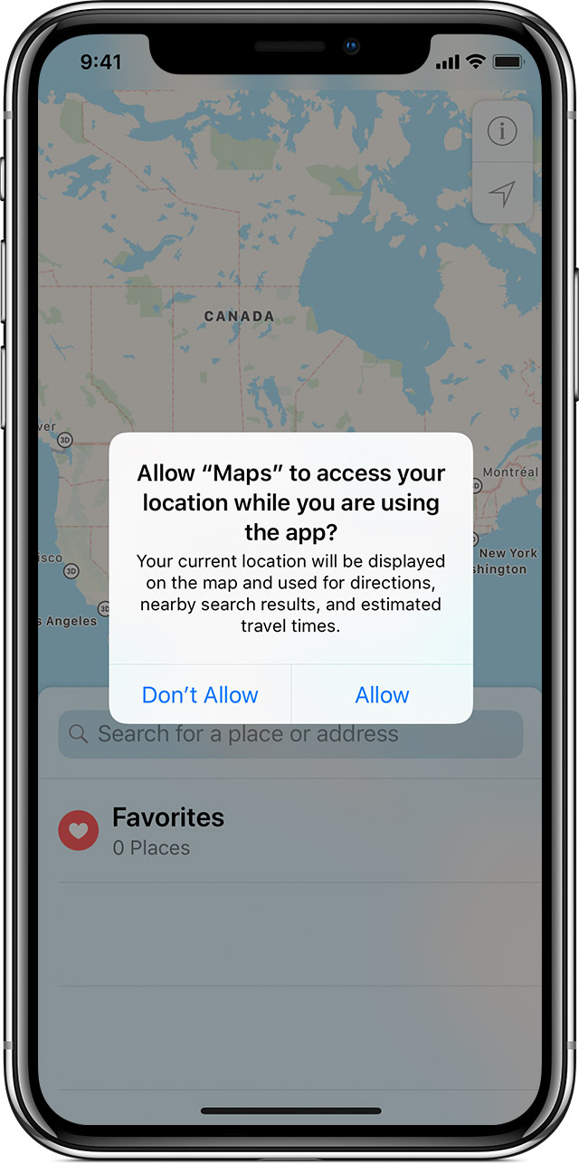
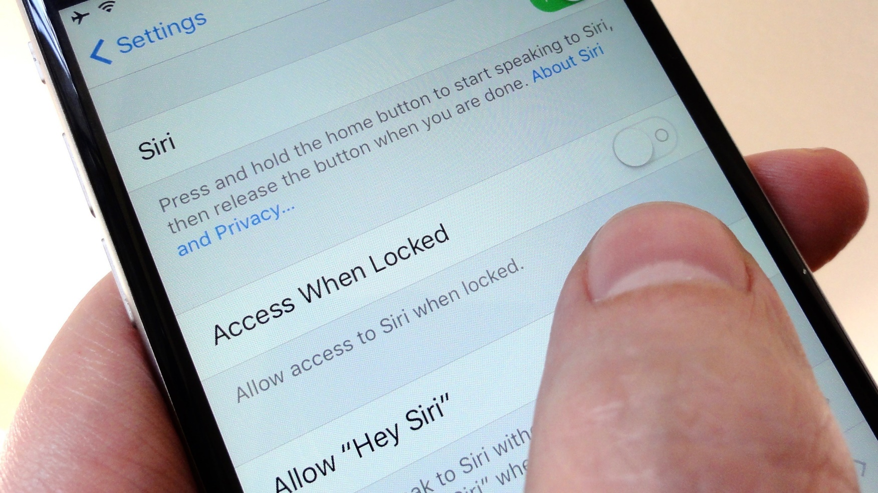
access
a way of entering or reaching a place

Slide 17
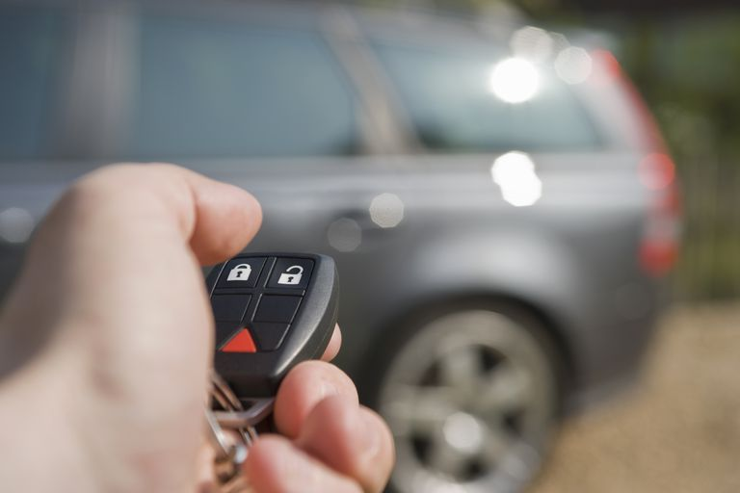
A slight movement can activate the car alarm.

Slide 18
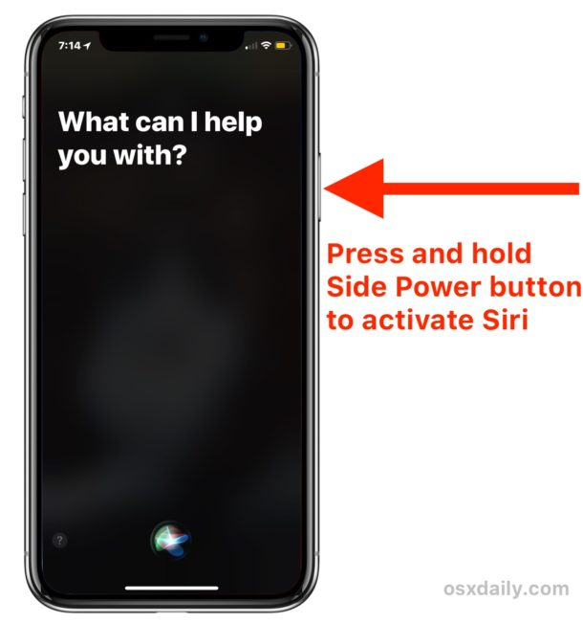
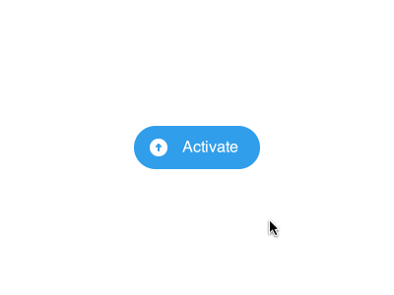
activate
to cause something to start

Slide 19

The sun reflects directly in the sea.

Slide 20

directly
straight

Slide 21




Slide 22
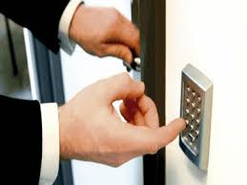
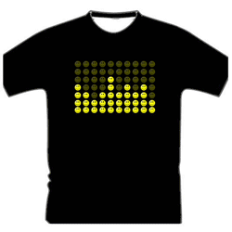

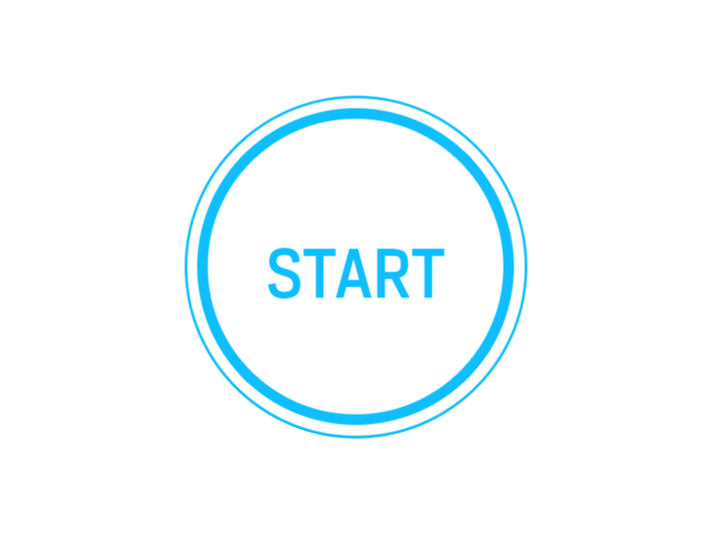
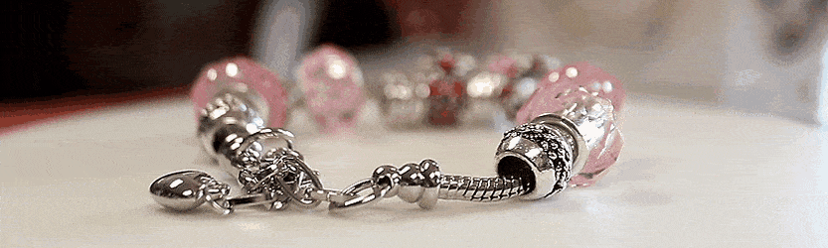

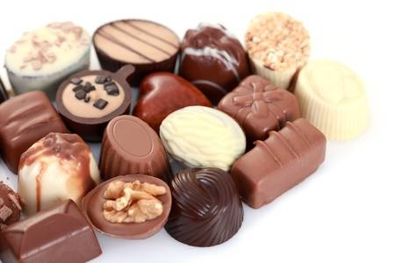
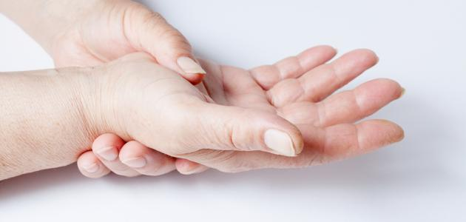
wearable (adv.)
bracelet (n.)
skin (n.)
access (n.)
activate (v.)
various (adj.)
directly (adv.)

Slide 23

Student’s Book
Page 67

Slide 24



Slide 25
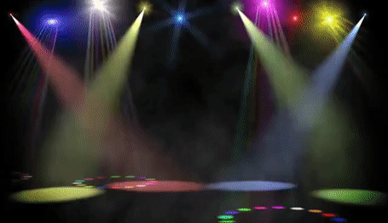
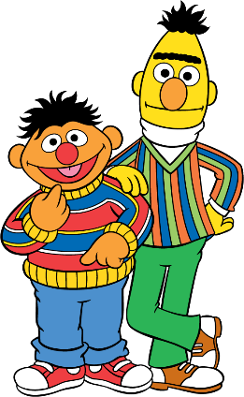
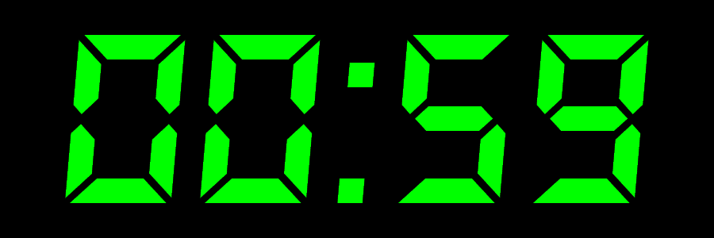

Slide 26

Read your answers.

Slide 27

If you could ask someone from the future about communication, what questions would you ask?

Slide 28



Slide 29
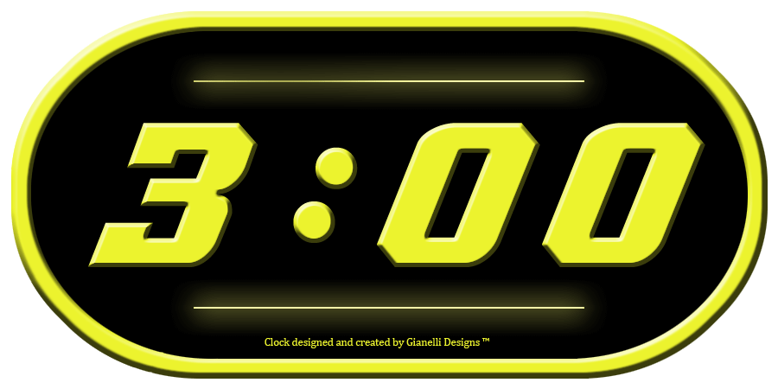
Write a name for each creative gadget.

Slide 30
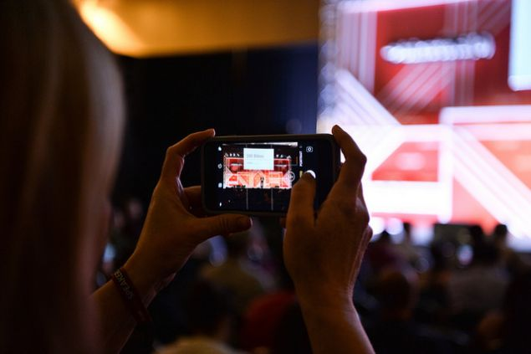
Read your answers.

Slide 31
Wearable bracelet
(A) ……………………………………………..
The next step in wearable technology will be
a bracelet that will make your skin your new touch screen. It will be able to project a touchscreen onto your arm, making it possible for you to easily access and use your apps without having to take out your phone. You can play games, answer your calls, check the weather, find your way and keep whatever you want on your arm.

Slide 32
Smart newspaper
(B) ……………………………………………..
It’s another creative gadget that is being designed to help users get access to the latest news. This gadget woks by connecting a smart newspaper to the Internet. The reader will be able to activate content ranging from audio to advertisements by touching various parts of the page.

Slide 33
Smart contact lenses
(C) ……………………………………………..
They look like normal lenses but they will have three tiny lasers and a micro mirror to reflect pictures directly into your eyes. There is no need to wear a smart watch, have a mobile phone, tablet or TV because these lenses can let you watch movies or read your messages without opening your eyes.

Slide 34

Student’s Book
Page 68

Slide 36
Read your answers.

Slide 37
1. What is the function of the bracelet?
It helps us to play games, answer our calls, check the weather, find our way and keep whatever we want on our arm.

Slide 38
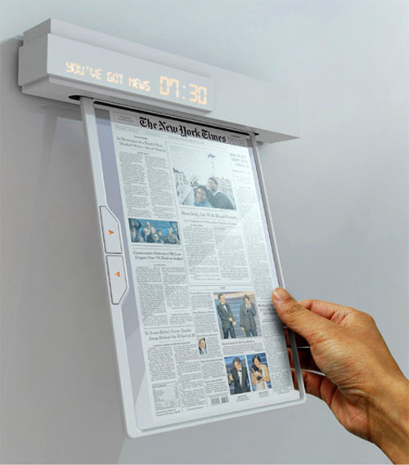
2. In what way is the newspaper creative?
It is being designed to help users get access to the latest news.
The reader will be able to activate content ranging from audio to advertisements by touching various parts of the page.

Slide 39
3. How will the lenses replace smart devices?
The lenses can let you watch movies or read your messages without opening your eyes.

Slide 40
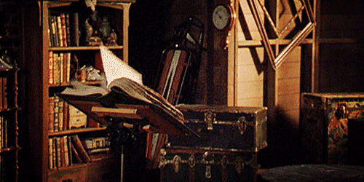


Slide 41
(A) ……………………………………………..
The next step in wearable technology will be
a bracelet that will make your skin your new touch screen. It will be able to project
a touchscreen onto your arm, making it possible for you to easily access and use your apps without having to take out your phone. You can play games, answer your calls, check the weather, find your way and keep whatever
you want on your arm.
Wearable bracelet

Slide 42
Smart newspaper
(B) ……………………………………………..
It’s another creative gadget that is being designed to help users get access to the latest news. This gadget woks by connecting a smart newspaper to the Internet. The reader will be able to activate content ranging from audio to advertisements by touching various parts of the page.

Slide 43
Smart contact lenses
(C) ……………………………………………..
They look like normal lenses but they will have three tiny lasers and a micro mirror to reflect pictures directly into your eyes. There is no need to wear a smart watch, have a mobile phone, tablet or TV because these lenses can let you watch movies or read your messages without opening your eyes.

Slide 44

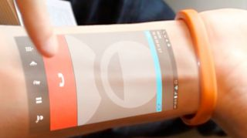

Slide 45
What is the purpose of the text?

Slide 46
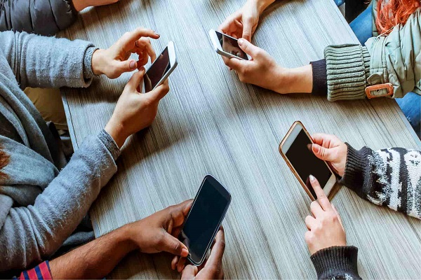
Closure

Slide 47

How would people communicate in the future?

Slide 48

Thank you

